Slide 1
Iot Health Monitoring System
Communication and Mini-Project

Slide 2
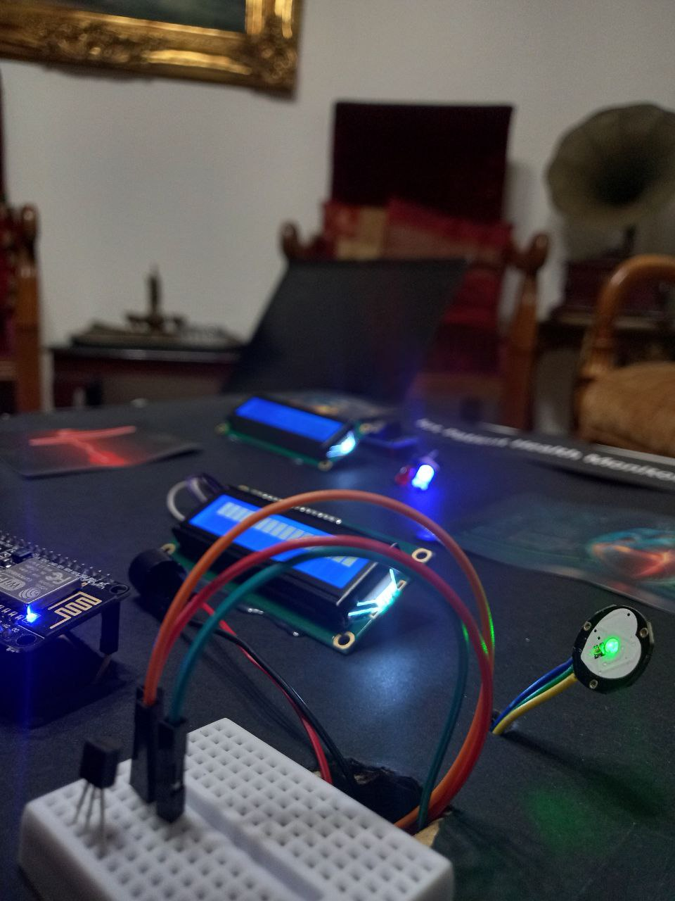
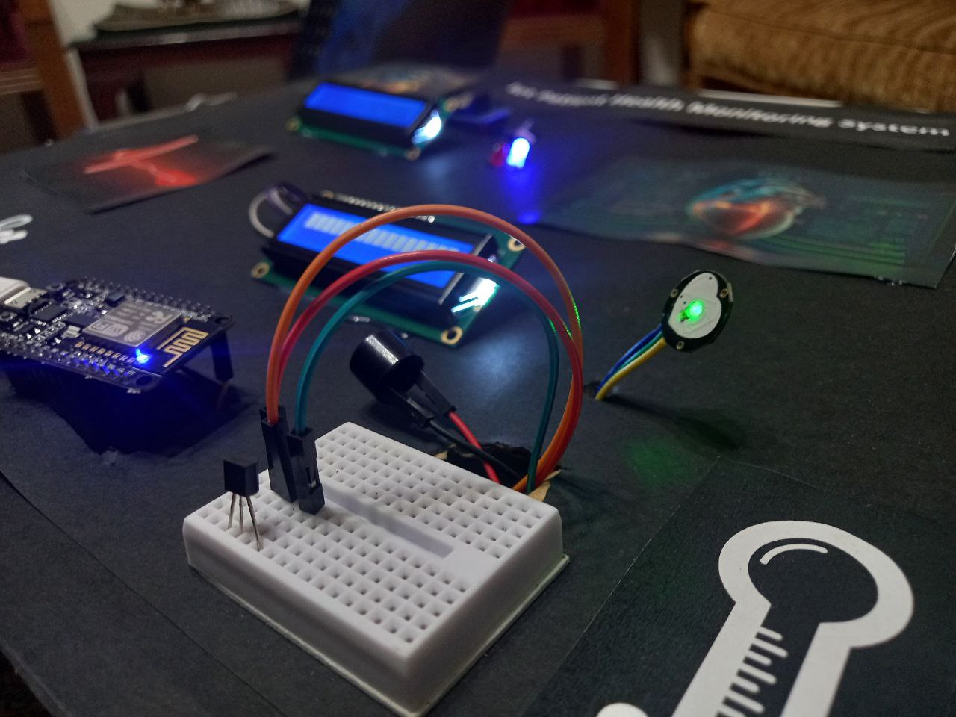

Slide 3
Table of contents
01
02
03
04
05
Our team
System Design
Results
System requirements
Use case diagram
System architecture
Real circuit
ThingSpeak
Implementation
Implementation tools
Two sub-circuit and components
How does this
system work

Slide 4
01
Our team

Slide 5

Our team
Marwa Chehab
Dana Dagher
6385
6436

Slide 6
02
System Design

Slide 7
System requirements
The healthcare system is divided into two sub-systems:

Slide 8
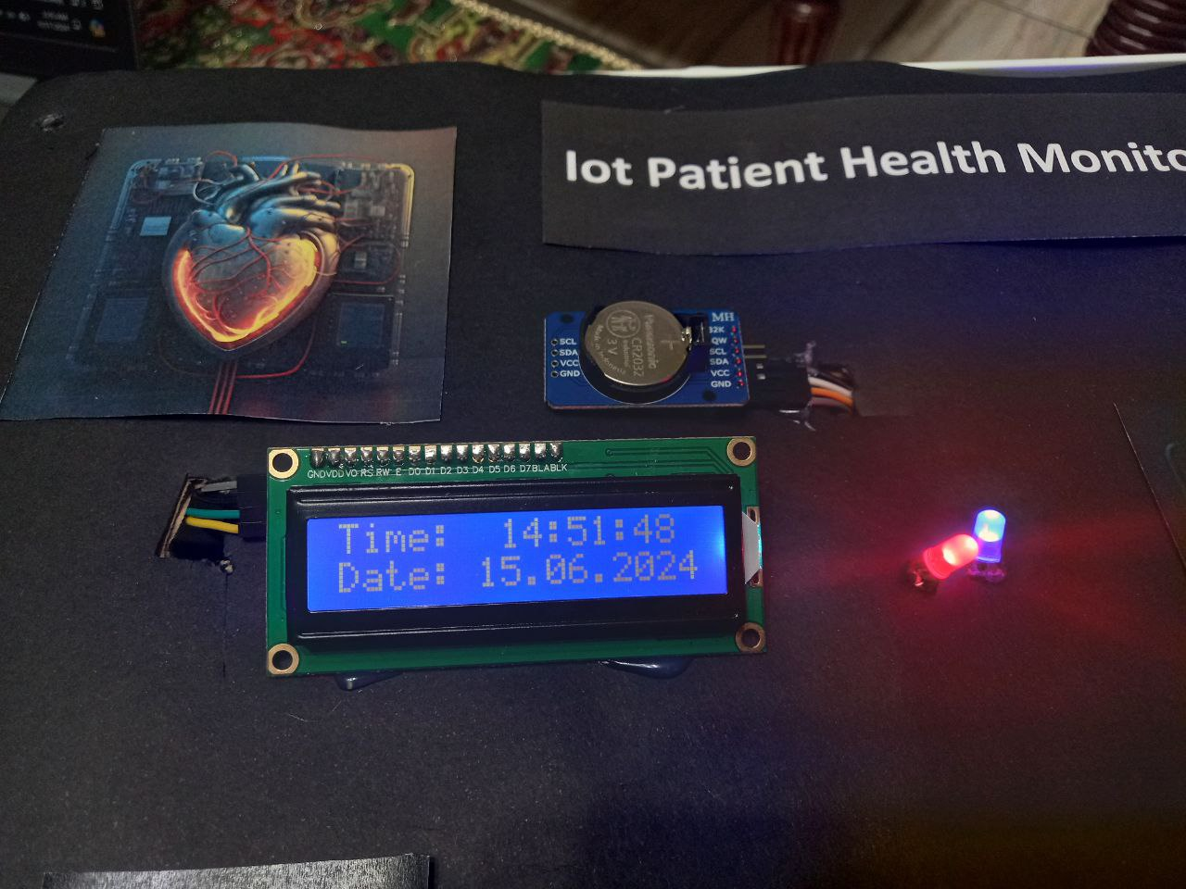
The first sub-system uses:
Uno board
The DS3231 RTC module
An LCD
Red and blue LEDs

Slide 9
2. The second sub-system involves:
A NodeMCU_ESP8266
A pulse sensor
A LM35
An LCD
A buzzer

Slide 10
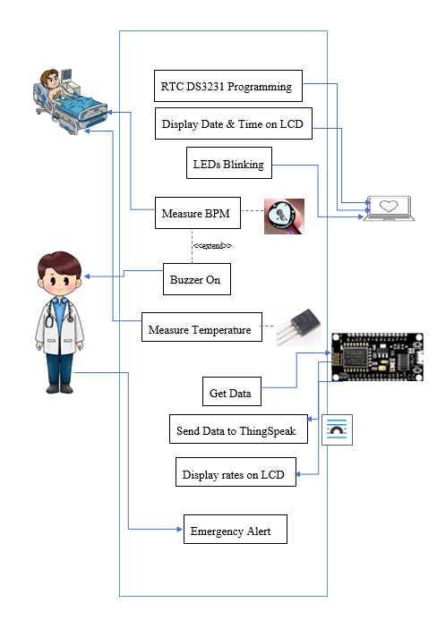
Use Case Diagram:

Slide 11
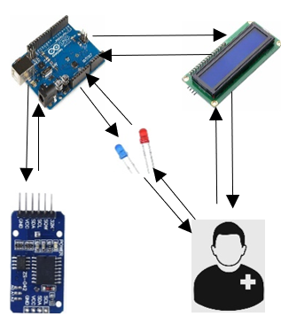
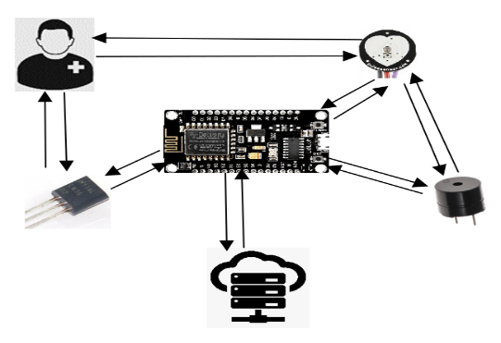
System Architecture:

Slide 12
03
Implementation

Slide 13
Implementation tools:
Components | Usage
Male to Female Jumpers | Components connectivity
Female to Female Jumpers | Components connectivity
Uno Board | Microcontroller
ESP8266 NodeMCU | Microcontroller with WIFI
LCD with I2C | Characters display
LEDs | ON/OFF
DS3231 RTC Module | Real time tracking
Active Buzzer | As an alert
LM35 | Temperature Sensor
Pulse sensor | Detect BPM

Slide 14
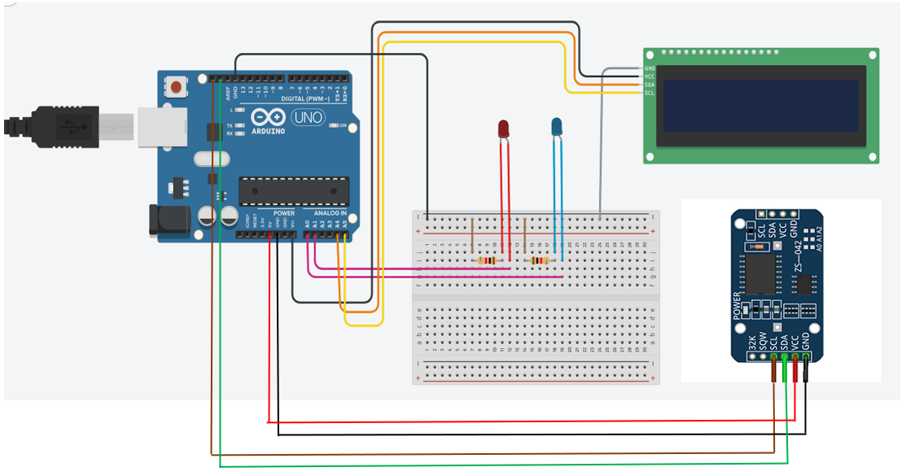
Two sub-circuit :
First circuit:

Slide 15
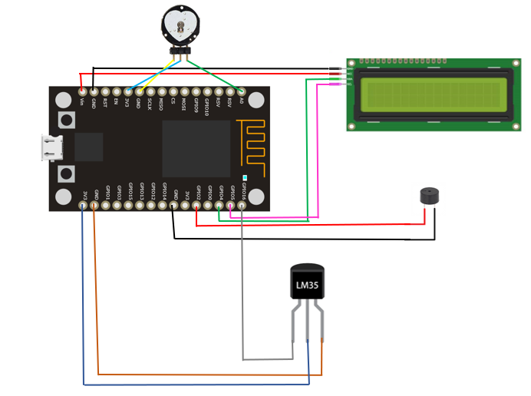
Two sub-circuit :
second circuit:

Slide 16
04
How does this system works?

Slide 17
Data collection:
LM35 temperature sensor : this sensor will measure body temperature and send an analogue output.
Pulse sensor: will detect pulse beat by sensing blood flow changes and produce an analog signal.

Slide 18
Data Processing:
The ESP8266 NodeMCU reads the analogue signal from pulse and temperature sensor through its analogue pins, process them and gives meaningful BPM and temperature values.

Slide 19
WIFI connectivity and data collection:
NodeMCU is connected to WIFI using credentials: ssid and password mentioned on the code.
ThingSpeak is the cloud platform used to collect and store sensor data in real time.
Steps:
Connect to WIFI
Formulate HTTP request by NodeMCU.
Send the HTTP request to ThingSpeak’s API.
Storing data and visualization.

Slide 20
05
Results

Slide 21
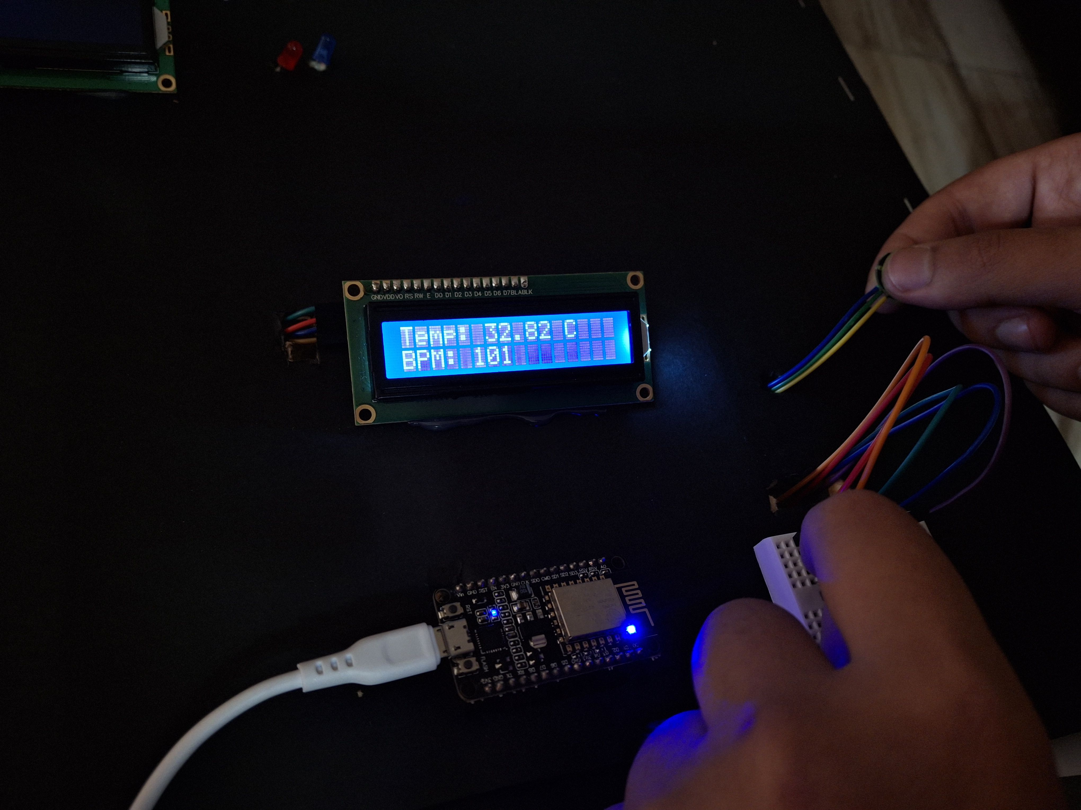
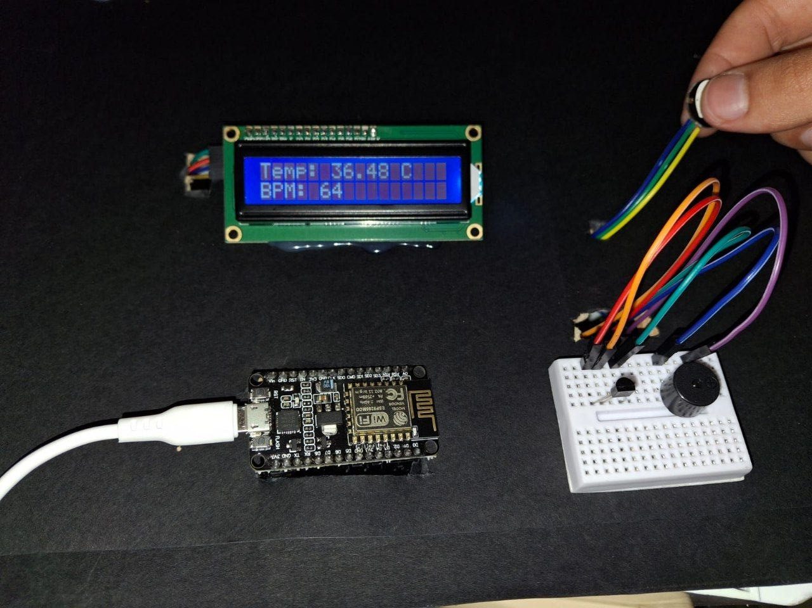
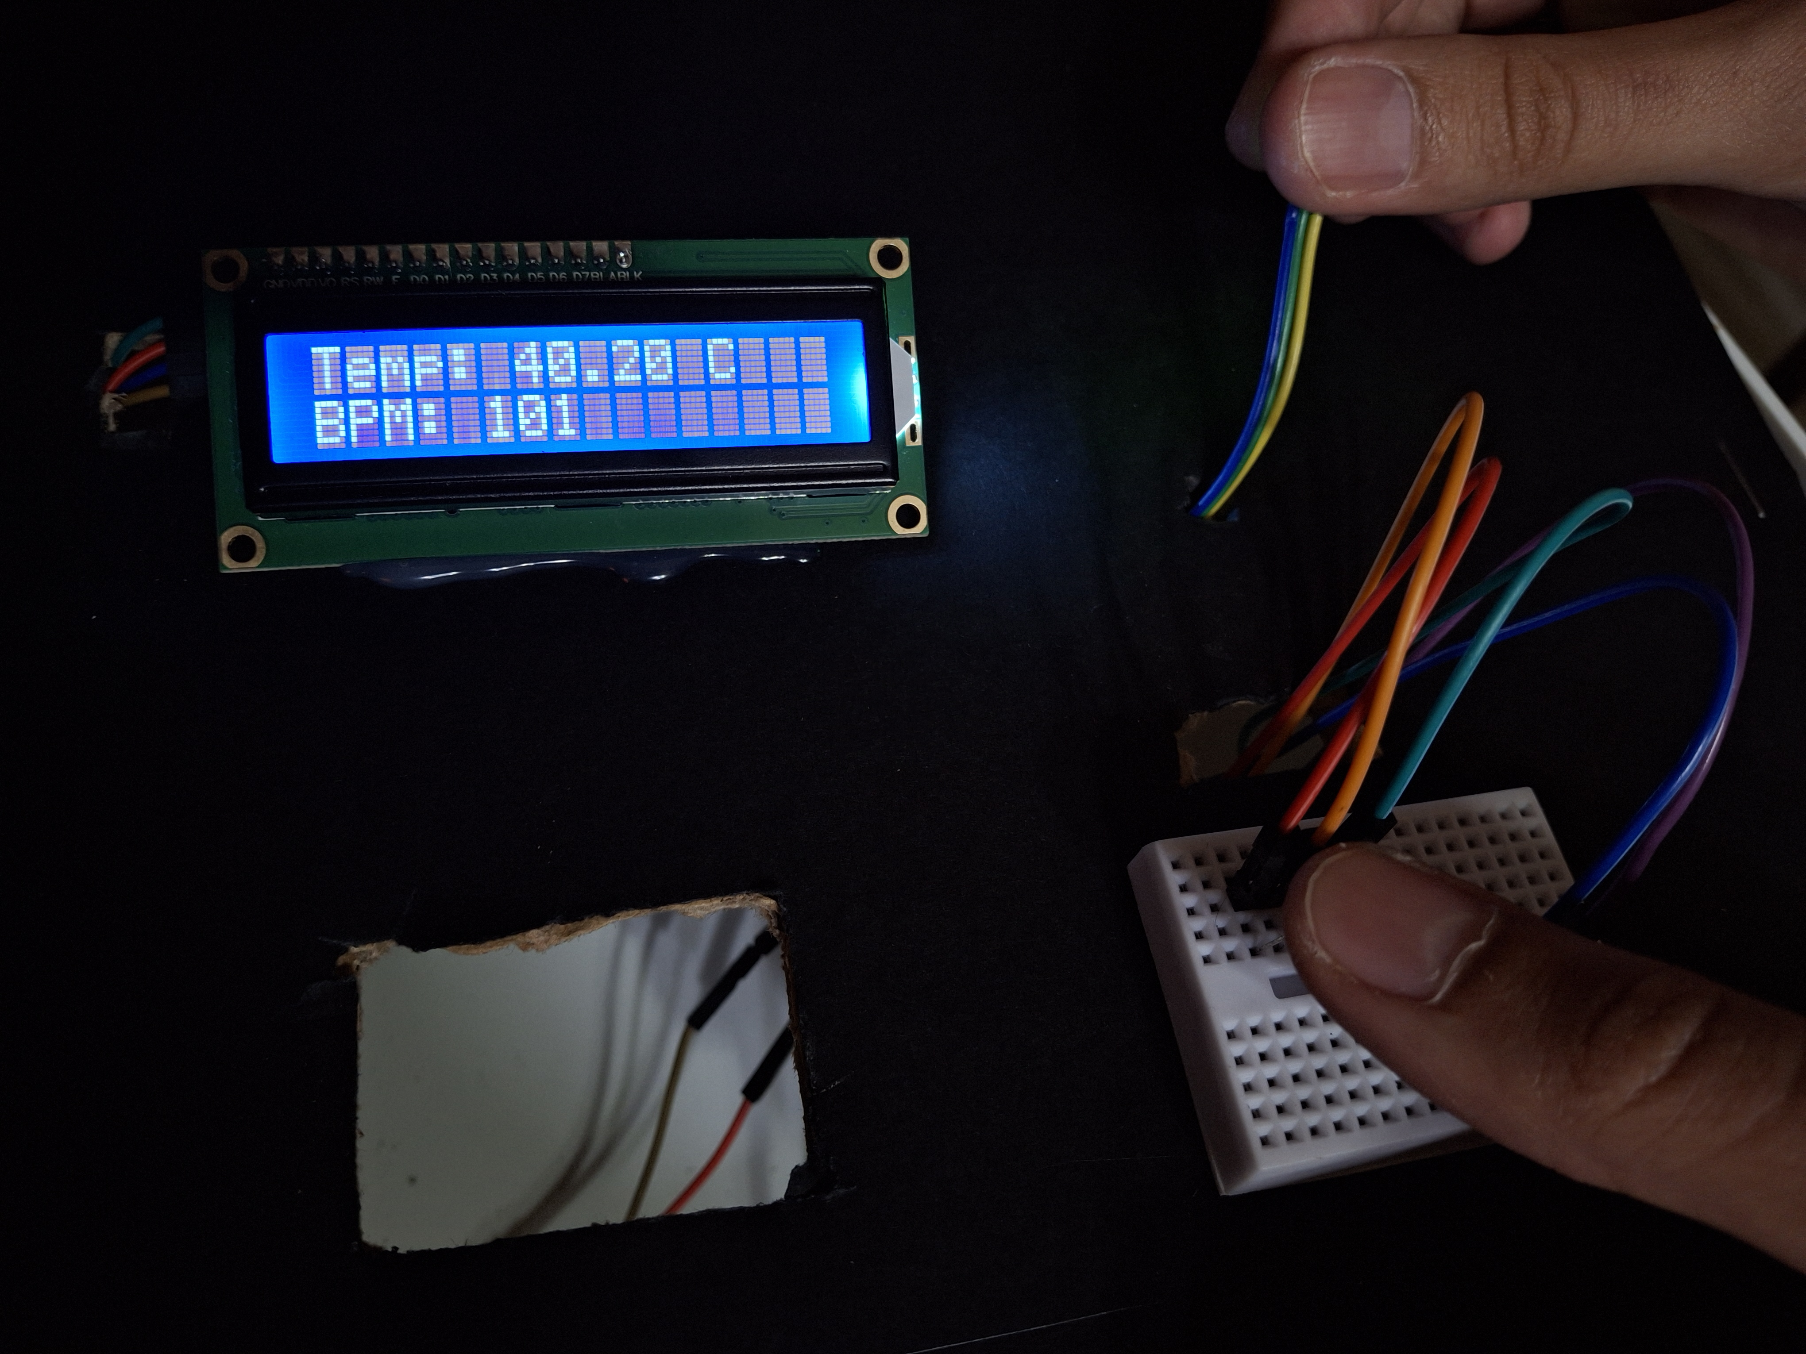
In real Circuit:

Slide 22
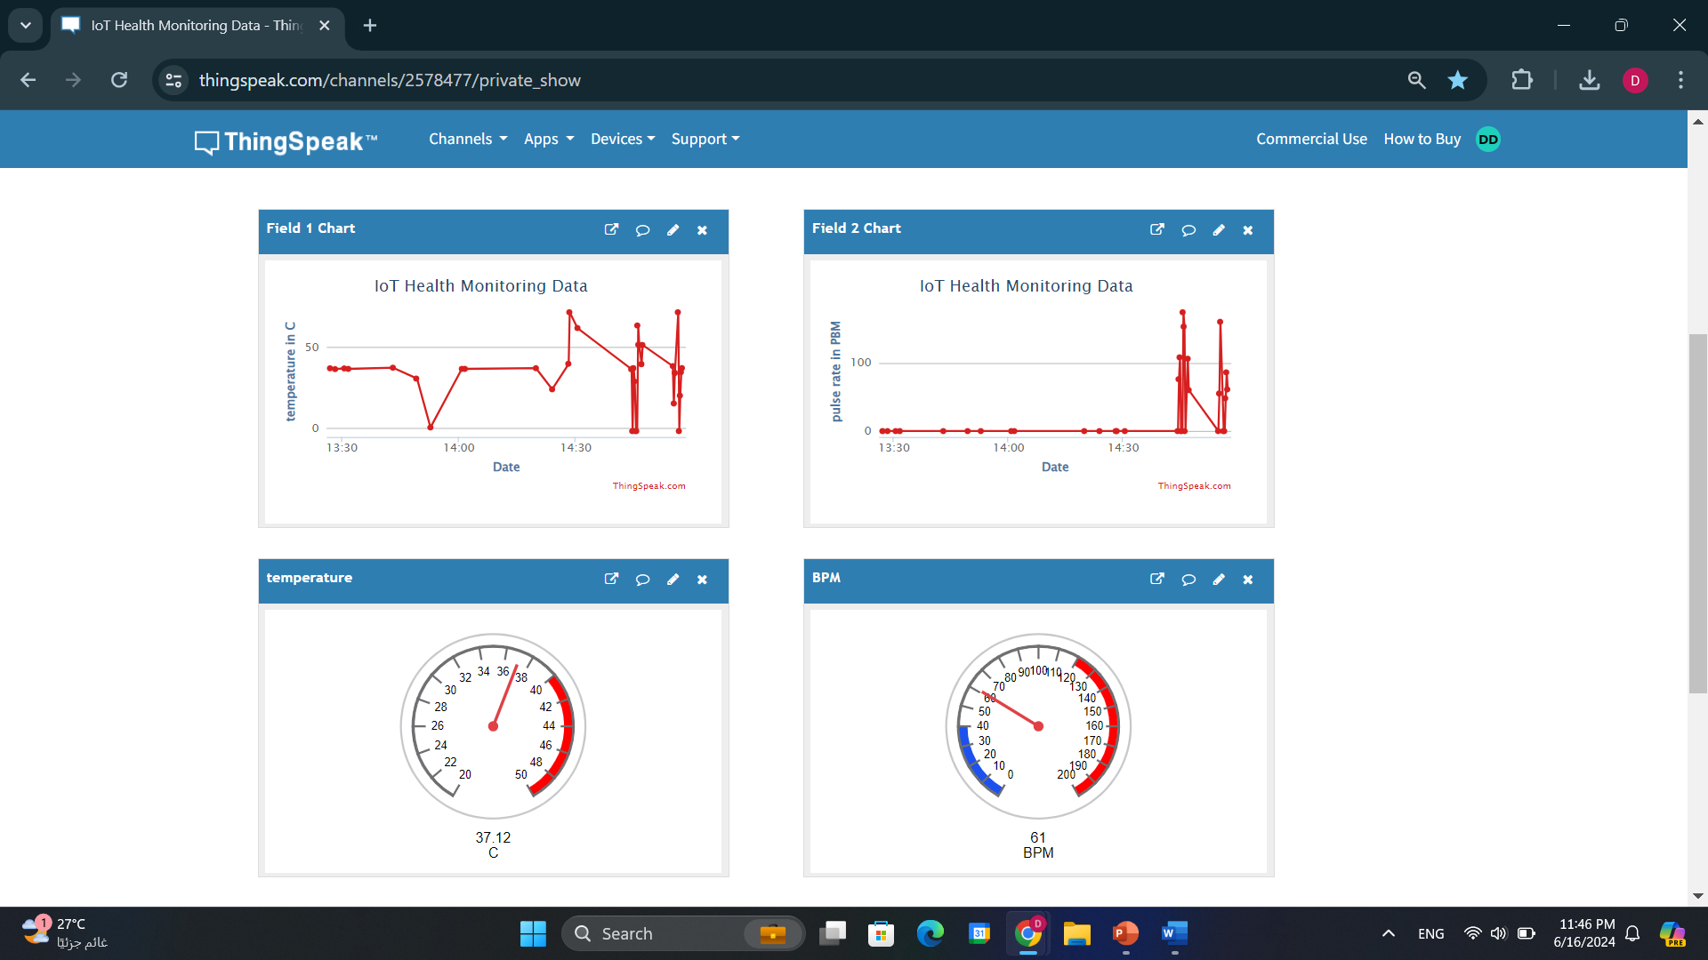
On ThingSpeak:

Slide 23
Thanks!
Any questions?

